Slide 1
New Title: What were the symptoms of the Black death?

Slide 2
Day 1 Painful swelling appear in the victim’s armpits and groin. They could swell to the size of an apple. | Day 2 The victim develops a fever and starts to vomit | Day 3 The blood vessels under the skin begin to break down and bleed. This causes black bruises to appear all over the body.
Day 4 The nervous system begin to be attacked causing the victim to twitch and spasm. This is very painful. | Day 5 Sometimes the buboes would burst and leak a foul smelling black liquid. When this happened the victim might live. Most victims would become unconscious and die.

Slide 3
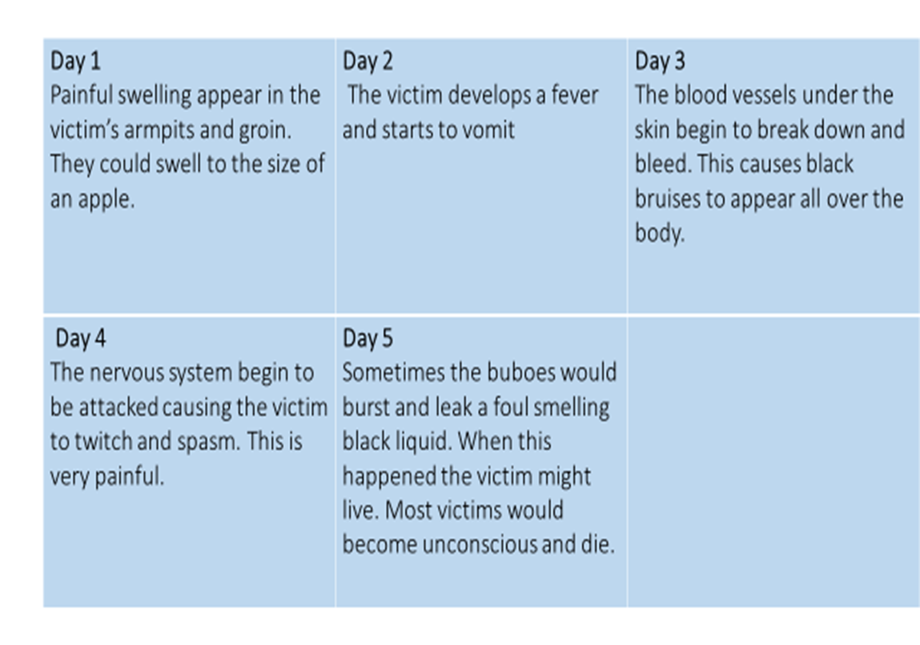

Task 4: Draw 5 stick men/women
Add notes onto each figure to show the different symptoms on each day. (Example below)
Day 1:
Buboes (swellings) under the arms

Slide 4
“ The victims died almost immediately. They would swell beneath the armpits and in the groin and fall over while talking. Fathers abandoned their child, wives their husband, one brother another. This illness seemed to strike through breath and sight… . In many places great pits were dug and piled deep with the dead. And they died by the hundreds, both day and night”
Task 5: Read this account…
Source A:
A first hand account from 1348

Slide 5
Task 6: Using the information from Source A fill in the gaps
Source A describes people with the Black death as having the following symptoms. The victims died almost………………… They had swellings in their……………..and……………………
Families did not stay together, but ran away from each other. The illness seems to be spread through………… and ………….. In many places great ……..are dug and piled with the……………….. They died in their …………………….. Both day and..................
Hundreds, Armpits, night, instantly, groin, sight, dead, pits, breath

Slide 6
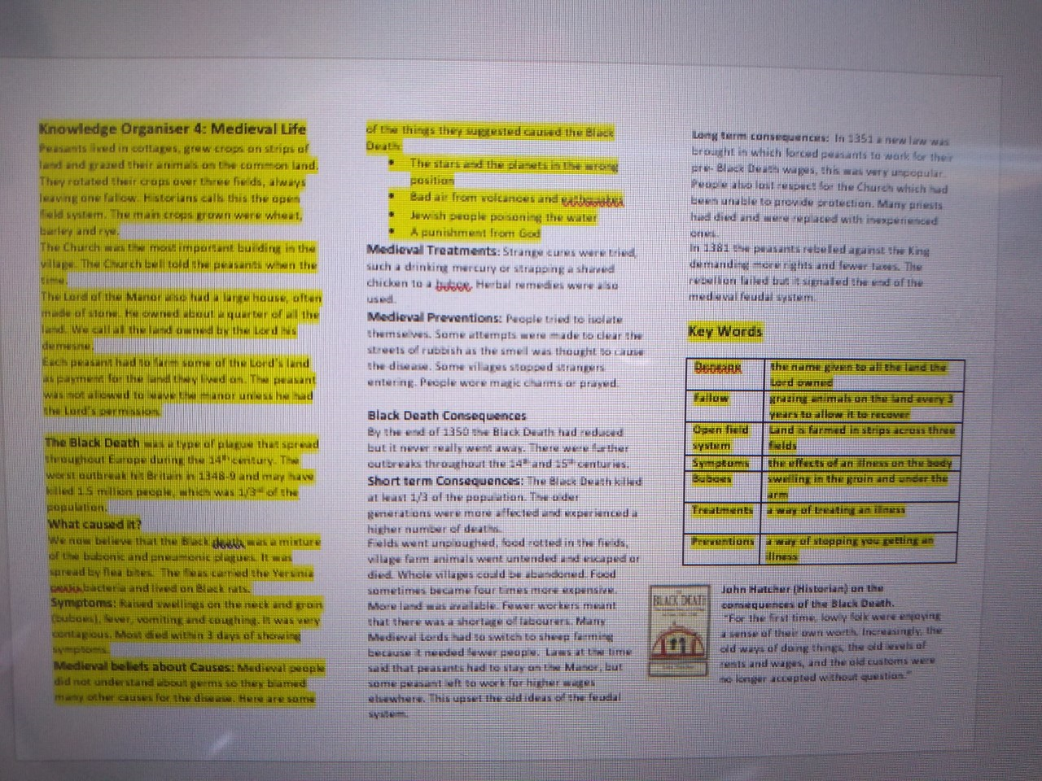
Now find your knowledge organizer for this unit. (It is attached to Class charts)
Task 7:
Revise the highlighted areas. Make a quiz and test yourself.

Slide 7
Answers : mark with your green pens.
Task 1
1. Weymouth, Dorset
2. 1348
3. Sailors from France
Task 2
4 Closed the city gates
5 The infection was already in the city.
6. Plague pits in the Cathedral grounds
THINK – answers on PPT. Note how the disease travelled along the trade routes from China, along the Mediterranean and up through Europe.
Task 3. Check you have copied your map correctly and labelled the key
Task 4. You should have 5 stick men with labels.
Task 6 on next slide..

Slide 8
Task 6 answers
Source A describes people with the Black death as having the following symptoms. The victims died almost…instantly They had swellings in their groin.. and…armpits
Families did not stay together, but ran away from each other. The illness seems to be spread through sight and …breath. In many places great ……pits..are dug and piled with the……dead………….. They died in their …………hundreds………….. Both day and............night..

